Slide 1
DETECTION AND BEHAVIOUR ANALYSIS OF BOT AND LEGITIMATE ACCOUNTS.
PRESENTED BY: PRESENTED TO:
Deepak Yadav 222IT004 Dr. Sowmya Kamath S
Abhishek yadav 222IT005
Neeraj Kumawat 222IT024

Slide 2
AGENDA
Introduction
Literature Survey
Outcome of Literature Survey
Problem Statement and Objectives
Existing Methodology
Dataset details
Proposed enhancements/novelty
Work done (Current status)
Individual Contribution

Slide 3
INTRODUCTION
Over the last decade, the rise of online social media has caused a huge shift in the way people find information through social media channels such as Twitter, Facebook etc.
Recent research has shown a substantial active presence of bots in online social networks.
They are created for a number of different purposes, e.g., news, marketing, political campaigning, spamming, and spreading malicious content.
Modeling and analyzing online user behaviours becomes crucial for a variety of reasons.
In this project we are analyzing the behavioral similarities between group of twitter users and detecting legitimate users and bot accounts.

Slide 4
LITERATURE SURVEY
Author/year | Methodology | Advantages | Limitations
Alessandro Bessi (2016) | Proposed a methodology HMM(Hidden Markov Model) based on intuitive probabilistic framework to model the unobserved (hidden states) orientation of individuals by taking into account their observed (visible states) actions in online social media. | The proposed methodology is straightforward to implement, and supported by sound and intuitive theoretical foundations. | High computational time required to train HMMs for a large number of individuals. Given complexity of human behaviour we can’t actually infer the actual orientation of users.

Slide 5
LITERATURE SURVEY
Author/year | Methodology | Advantages | Limitations
Nivranshu Pasricha and Conor Hayes (2019) | In this approach, they used a lossless compression algorithm on Digital DNA sequences and use the compression statistics as a measure of predictability in the behaviour of a group of Twitter accounts. | This approach is fast and can be scaled to handle large number of accounts with the advantage of being language and content independent. | This approach did not incorporate user-profile and content-based features into the digital DNA sequence

Slide 6
OUTCOMES OF LITERATURE SURVEY
A major challenge faced by online social networks is the remarkable rise of fake and automated bot accounts and many authors came up with different approaches to analyze and modeling the behaviour analysis of users on social media.
Alessandro Bessi used intuitive probabilistic approach to draw the behavioral trajectories of users in online social media and it requires more research to support the claims.
Nivranshu and conor used lossless compression algorithm on digital DNA sequence but it requires more features to include into DNA sequence such as content based features(media, URLs, mentions etc. in the content).

Slide 7
PROBLEM STATEMENT
DNA inspired techniques to see the behavioral similarities and detection of bot accounts in twitter.
Research Objectives
1.Digital DNA sequence.
2.Similarities within group of users.
3.Detection of bot account and legitimate account.

Slide 8
DATASET DETAILS
Dataset is taken from : http://mib.projects.iit.cnr.it/dataset.html
Our dataset consists of 9.5 millions tweets.
User details are divided in four categories.
1.Legitimate users is 3.5 thousand user accounts approximately.
2.Spam_Bot 1: 991 users ->Political candidates.
3.Spam_Bot 2: 3457 users-> Promote an app for mobile devices.
4.Spam_Bot 3: 464 users->E-commerce.

Slide 9
EXISTING METHODOLOGY
1.DIGITAL DNA SEQUENCE:
We are using three techniques in digital DNA sequence, B3 TYPE , B3 CONTENT , B6 CONTENT.
2.LONGEST COMMON SUBSTRING:
LCS is used to find the similarity between DIGITAL DNA SEQUENCE. A higher value of AREA UNDER THE CURVE describes that there exists high similarity between the group of users and vice versa.
3.FOLLOWERSHIP FRIENDSHIP:
On the basis of friend follower distribution and follower ratio, we will distinguish legitimate and bot accounts.

Slide 10
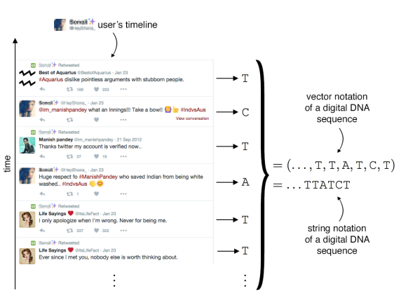
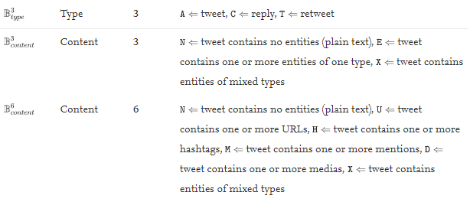
EXISTING METHODOLOGY(CONTD.)

Slide 11
NOVELTY
A novel approach to distinguish legitimate and bot twitter accounts with the support of machine learning approaches.
Three different machine learning algorithms are used in this project.
Random forest, Decision tree, Ada-boost.

Slide 12
WORK DONE
Preprocess the dataset
Generate the Digital DNA sequence for Legitimate User and Bot User group 1 using B3_type, B3_content and B6_content method..
Finding the longest common substring of all the generated DNA sequences.
Plotting the LCS Curve.
Finding the AUC of LCS Curve
Calculating the Follower Ratio of Legitimate User and Bot User group.
Plotting Follower Frequency and Friend Frequency of each group user.
Bot detection using different machine learning algorithm like Decision Tree, Random Forest, Ada- Boost.

Slide 13
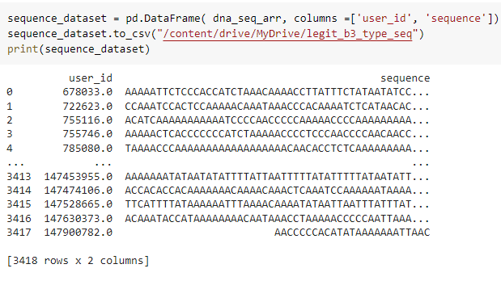
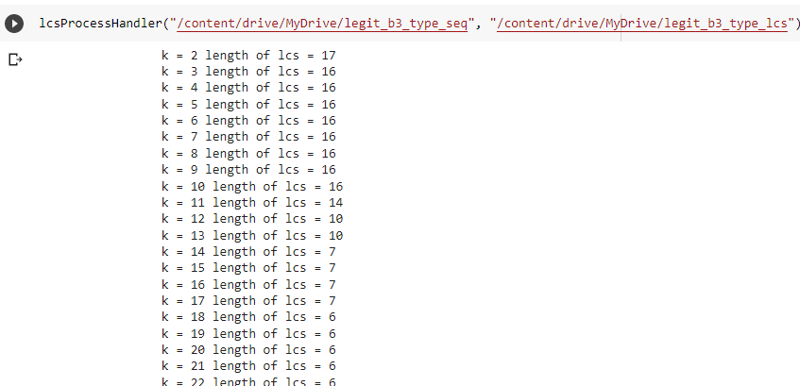
RESULTS
1.DNA SEQUENCE AND LCS FOR LEGIT_USER USING B3_TYPE

Slide 14
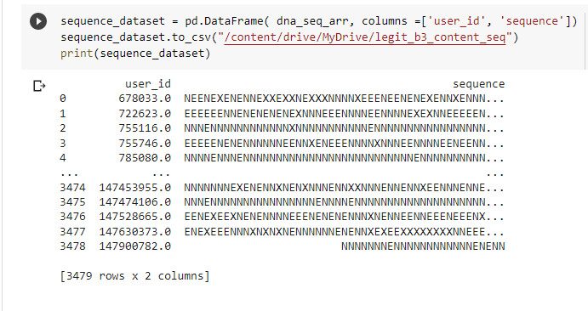
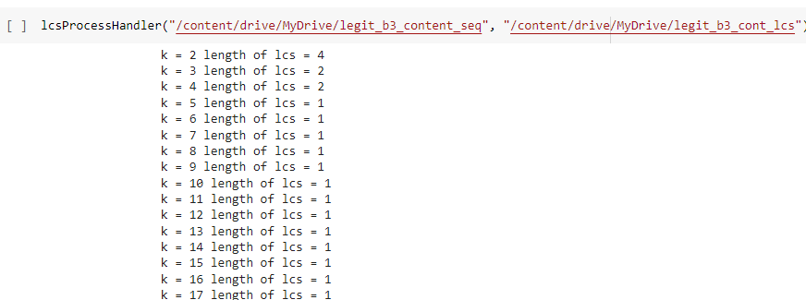
2. DNA SEQUENCE AND LCS FOR LEGIT_USER USING B3_CONTENT

Slide 15
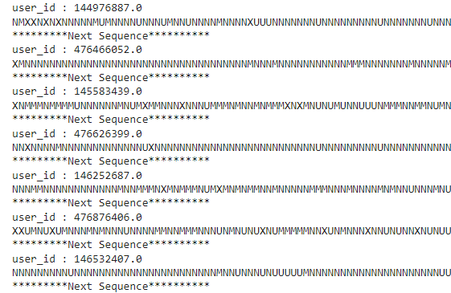
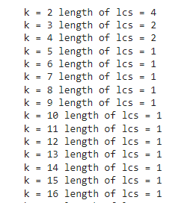
3. DNA SEQUENCE AND LCS FOR LEGIT USER USING B6 CONTENT

Slide 16
AREA UNDER THE LCS CURVE
ACCOUNT_TYPE | AVERAGE AUC
BOT-1 USER | 3222.1866203359637
BOT-2 USER | 4453.768851009539
BOT-3 USER | 43739.99544211811
LEGITIMATE USER | 2252.2957607422527

Slide 17
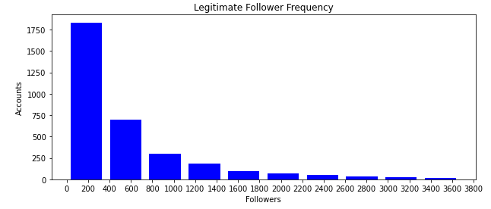
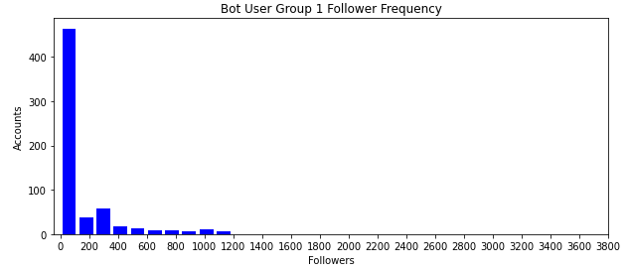
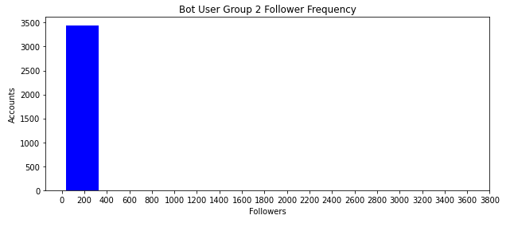
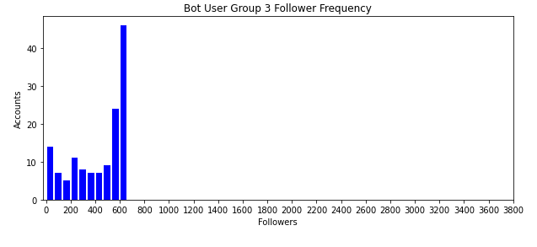
FOLLOWER FREQUENCY

Slide 18
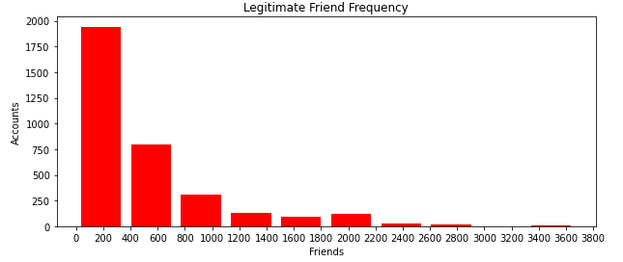
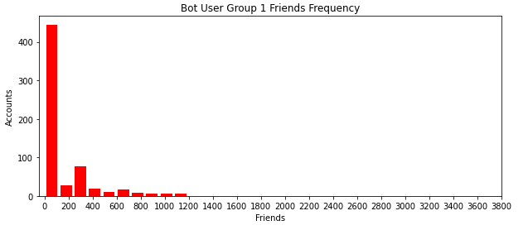
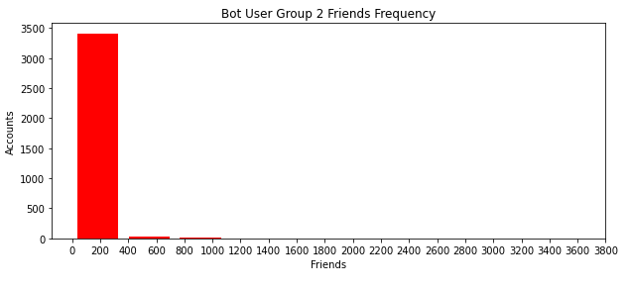
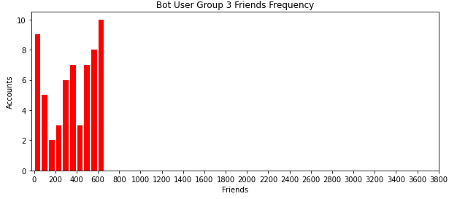
FRIENDS FREQUENCY

Slide 19
FOLLOWER RATIO OF EACH GROUP
ACCOUNT_TYPE | FOLLOWER RATIO
LEGITIMATE_USER | 0.5027722347999388
BOT1 | 0.3635857625153299
BOT2 | 0.11536390817579469
BOT3 | 0.11536390817579469

Slide 20
BOT DETECTION USING MACHINE LEARNING

Slide 21
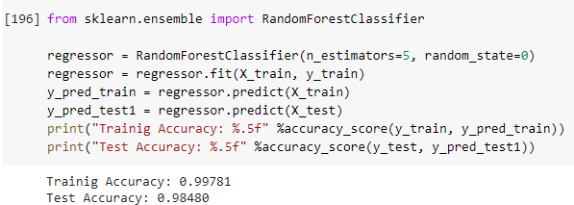
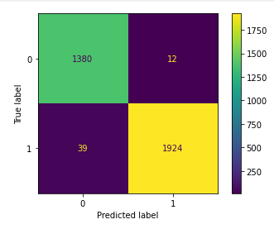
RANDOM FOREST

Slide 22
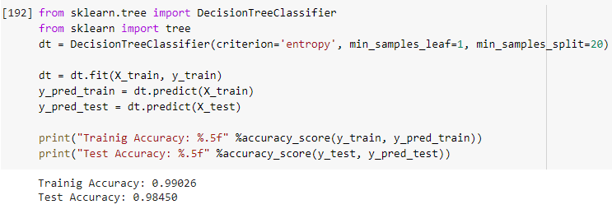
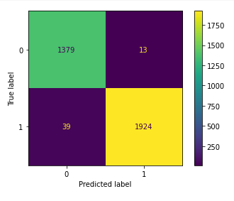
DECISION TREE

Slide 23
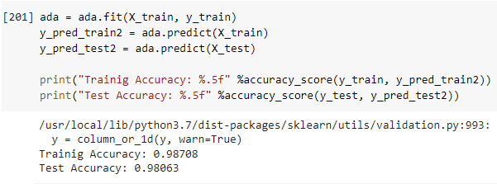
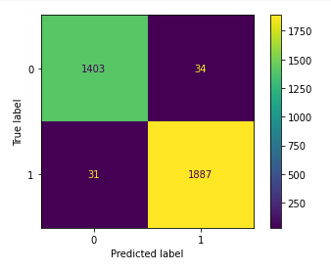
ADA-BOOST

Slide 24
RESULT COMPARISON
Models | Accuracy | Recall | F1_Score
Random Forest | 0.98480 | 0.98330 | 0.9829
Decision Tree | 0.98450 | 0.98708 | 0.9802
Ada-Boost | 0.98063 | 0.9833 | 0.9802

Slide 25
CONCLUSION
One of the foremost problems in social media platforms like Twitter is the large number of automated generally used for malicious activities, political benefits, and commercial advertisements.
In this project, we seek deep insights in the behavioral properties and similarities on the real world Twitter dataset we used for the experiments generated a digital DNA sequence and then computed the similarities using the LCS.
We applied machine learning algorithm to classify between legitimate account and bot account.

Slide 26
FUTURE WORK
In our project, we generated DNA sequence on the basis of B3 type, B3 content, B6 content, for future purpose we can use interaction, account age for generating DNA sequence.
For behavioural analysis we can also check the mention ratio, URLs ratio, Tweet frequency.
For differentiating between bot account and legitimate account we can use deep learning models.

Slide 27
INDIVIDUAL CONTRIBUTION
GENERATING DIGITAL DNA SEQUENCE (Deepak Yadav)
FINDING LONGEST COMMON SUBSTRING (Abhishek Yadav)
CALCULATING FOLLOWER RATIO (Neeraj Kumawat)
BOT DETECTION USING MACHINE LEARNING (Neeraj Kumawat)

Slide 28
REFERENCES
Cresci S., Di Pietro R., Petrocchi M., Spognardi A., Tesconi M. DNA-inspired online behavioral modeling and its application to spambot detection.
Pasricha, Nivranshu, & Hayes, Conor. (2019). Detecting bot behaviour in social media using digital DNA compression. Paper presented at the 27th AIAI Irish Conference on Artificial Intelligence and Cognitive Science Galway, Ireland, 05-06 December
Towards the Modeling of Behavioral Trajectories of Users in Online Social Media
Aarnold M., Ohlebusch E.Linear time algorithms for generalizations of the longest common substring problems

Slide 29
THANK YOU

